Slide 1

Sismics Books Project-1 Team_11
TEAM_11

Slide 2

Strategy Employed for Project Completion
Distribute tasks following team discussion.
Collaboratively install required project tools.
Identify classes with team coordination.
Draw UML diagrams for each Subsystem.
Detect design smells using SonarQube.
Analyze existing code with Code Metrics.
Refactor code individually for design smells.
Create GitHub issues, assign within team.
Review and merge code into master.
Reanalyze code using CodeMR.
Compare manual and LLM refactoring.
Simultaneously completed bonus tasks.
TEAM_11

Slide 3
Distribute Tasks Following Team Ddiscussion
Task No | Task Name | Task Description | Member Name | %
Task 1 | 1. Book Addition & Display Subsystem | For each subsystem separately, Identify relevant Classes, Document Functionality and Behavior, Create UML Diagrams, and Provide Observations and Comments, Along with any applicable Assumptions. | Vilal Ali Madan NS | 50 50
 | 2. Bookshelf Management Subsystem |  | Vilal Ali Madan NS | 60 40
 | 3. User Management Subsystem |  | Vilal Ali Madan NS | 60 40
Task 2 | 2a. Detect 5-7 design smells | Sonarqube as the primary tool to identify 5-7 design smells in code, focusing on structures and patterns indicative of violations to fundamental design principles, recognizing the potential for recurring issues in development. | Vilal Ali Shriom Tyagi | 60 40
 | 2b. Code Metrics Analysis | We have used popular tools like CodeMR to compute the code quality metrics on the Books project. CodeMR along with the code metric, generates comprehensive visualizations on it. | Vilal Ali | 100
Task 3 | 3a. Refactor 5-7 design smells | In Task 2a, we identified and analyzed 7+ design smells within the existing codebase. Now, the objective is to rectify these issues through code refactoring without fundamentally altering the structure of the code. | Vilal Ali Shriom Tyagi Hanuma Madan NS | 35 30 20 15
 | 3b. Code Metrics: After Refactoring | Post-refactoring, analyze code metrics using CodeMR, which not only provides metrics but also generates comprehensive visualizations for a more thorough understanding of the codebase. | Vilal Ali | 100
 | 3c. Leveraging LLM for Refactoring | Leverage advanced language models like GPT-3.5 or bard for refactoring code snippets identified with design smells. After manually refactoring the snippets, use the language models to generate alternative versions, comparing clarity, conciseness, and adherence to best practices | Vilal Ali Hanuma | 60 40
Bonus | Automated Refactoring Pipeline | design and implementation of an automated pipeline for detecting design smells in a GitHub repository, refactoring the identified issues, and generating pull requests for the changes. | Hanuma | 100
TEAM_11

Slide 4

Collaboratively Install Required Project Tools
Tools Installed for Project Development
Installed Java Version.
Set up Sonarqube for analysis.
Integrated CodeMR for code metrics.
Configured IntelliJ for development.
Installed ChatGPT 3.5 and Phind for assistance.
Challenges Encountered During Project Setup and Execution
New to Java projects before this endeavor.
Project utilizes Java 11; Sonarqube and CodeMR require the Java 17.
Switched to Java 17; Sonarqube ran but project malfunctioned. Reverting to Java 11, Sonar and CodeMetrics failed, causing frustration.
Implemented SDK for Java Version Control.
While using LLM for code refactoring, encountered the issue of fixing one problem only to cause another. After numerous trials and learning from the experiences, successfully resolved the challenges.
Initial impressions upon reviewing the code repository.
TEAM_11

Slide 5
Identify Classes With Team Coordination
Identified Classes In Book Addition & Display Subsystem
AppContext, AppResource, BaseResource, Book, BookDao, BookDataService, BookImportAsyncListener, BookImportedEvent, BookResource, TagDao, TagDto, TagResource, UserBook, UserBookDao, UserBookDto, UserBookTag, AnonymousPrincipal
Identified Classes In Bookshelf Management Subsystem
AppContext, AppResource, BaseResource, Book, BookDao, BookDataService, BookImportAsyncListener, BookImportedEvent, BookResource, SortCriteria, UserBookDao, UserBookCriteria.
Identified Classes In User Management Subsystem
AppContext, AppResource, BaseResource, ConnectResource, FacebookService, QueryParam, AuthenticationToken and AuthenticationTokenDao, User, UserResource, UserApp, UserAppCreatedEvent, UserAppCreatedAsyncListener, UserContact, UserDao, UserDto , UserAppDao, UserAppDto ,UserContactDao, UserContactDto, UserContactCriteria
TEAM_11

Slide 6
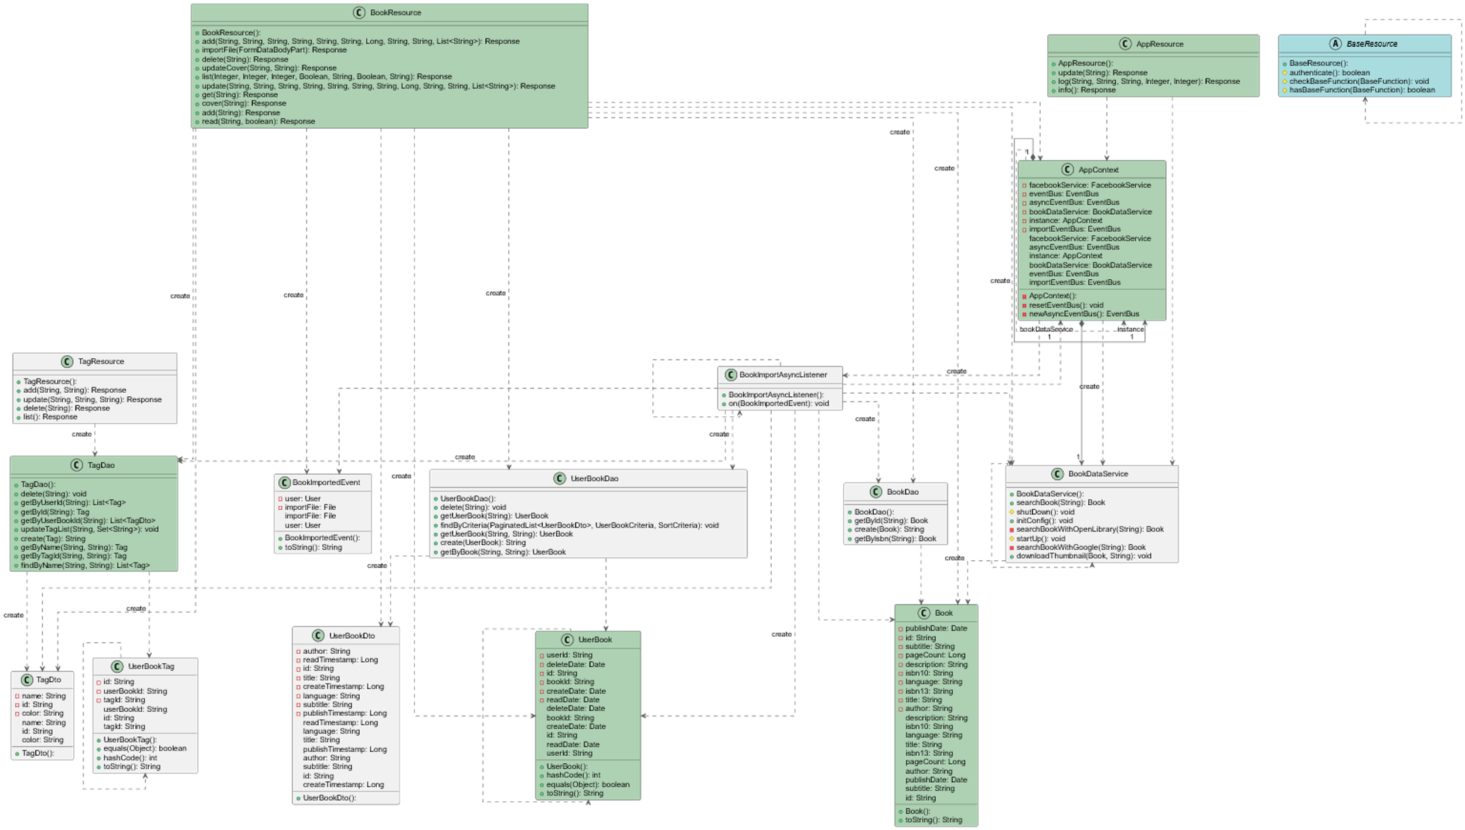
UML Diagrams for Each Subsystem
Book Addition Display Subsystem
TEAM_11

Slide 7
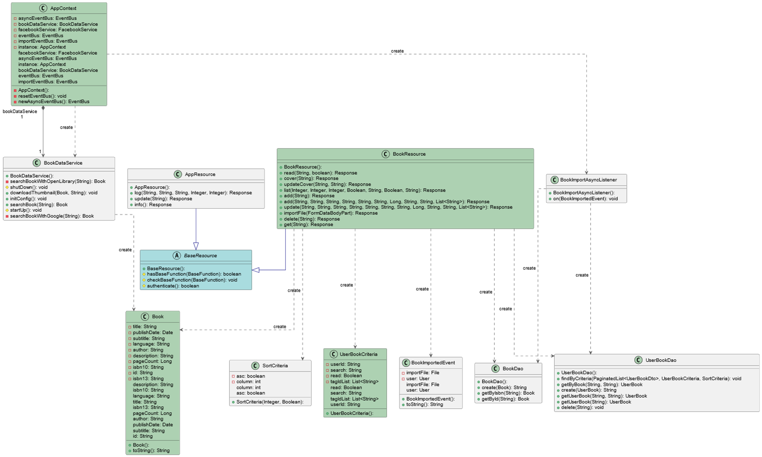
UML Diagrams for Each Subsystem ...
Bookshelf Management Subsystem
TEAM_11

Slide 8
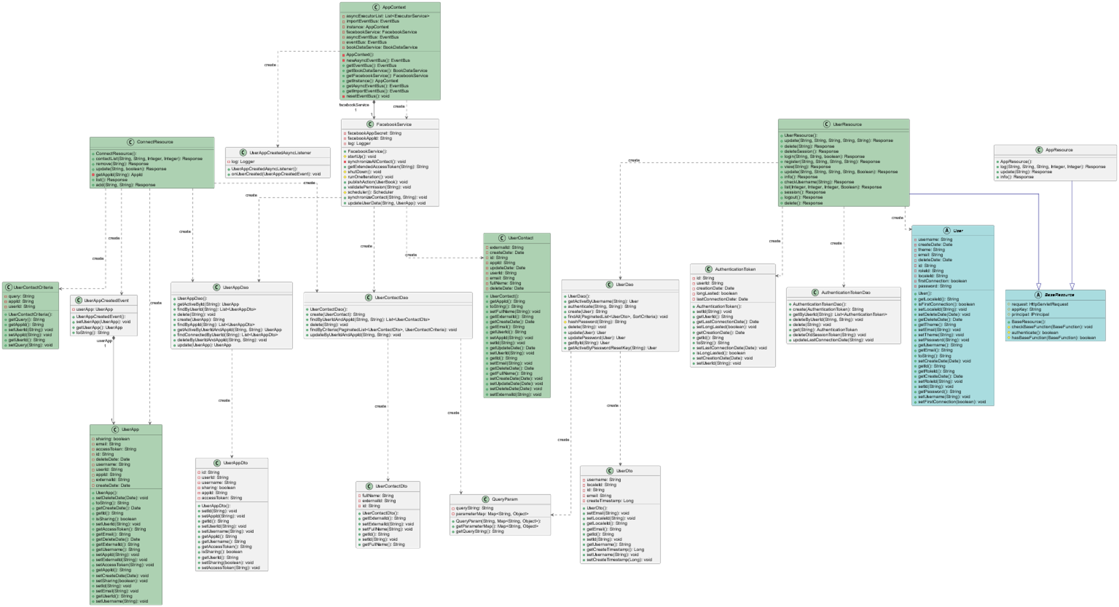
UML Diagrams for Each Subsystem...
User Management Subsystem
TEAM_11

Slide 9
Detect Design Smells help of SonarQube
Where is the design smell?
books-web/src/main/java/com/sismics/books/rest/resource/BookResource.java
Large Class, Long Method, Lack of Dependency Injection
Solution: Based on the identified design smells, We will refactor the code by breaking down long methods, introducing dependency injection, and replacing magic strings with constants. Here's the refactored version of the BookResource.java
books-core/src/main/java/com/sismics/books/core/constant/Constants.java
Lack of Encapsulation, Global State
Solution: we can refactor the Constants.java class to use a more object-oriented approach. One way to do this is to create separate classes for each group of related constants, encapsulating them within those classes.
books-core/src/main/java/com/sismics/books/core/listener/async/BookImportAsyncListener.java
Large Class, Long Method, Lack of Dependency Injection, Switch Statements, Duplication
Solution: We can refactor the code by extracting methods, and simplifying the logic.
books-core/src/main/java/com/sismics/util/ResourceUtil.java
Feature Envy, Long Method, Data Clumps, Switch Statements
books-core/src/main/java/com/sismics/util/HttpUtil.java
Resource Management, Many resources in Java need be closed after they have been used.
Solution: Try-with-Resources: The BufferedReader is declared within the parentheses of the try statement
books-web/src/main/java/com/sismics/books/rest/resource/BaseResource.java
Redundant Null Check, Unthrown Exception in Method Signature.
Solution: Redundant Check Elimination: The superfluous null checks preceding the instanceof operator have been eliminated from the authenticate() method.
books-web/src/main/java/com/sismics/books/rest/resource/BaseResource.java
Large Class, Feature Envy, Lack of Encapsulation.
Solution: We can extract the authentication logic into a separate AuthenticationService class to adhere to SRP.
TEAM_11

Slide 10

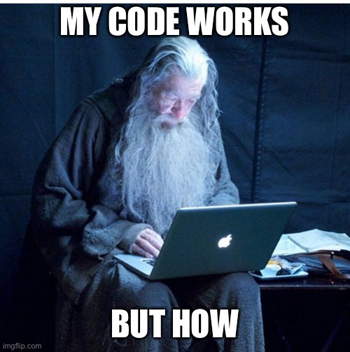
Refactor Code Individually for Design Smells
For further details, kindly refer to the project report by clicking here
TEAM_11

Slide 11
List of Created issues and PR on GitHub
S. No. | Design Smell | Task Description | #Issue | Assignee | PR | Reviewed
01 | Large Classes or Large Methods | Refactor 'Brain Method' to reduce LOC, complexity, nesting, and variables. | #15 | Vilal | #26 | Shriom
02 | Encapsulation | Add a private constructor to hide the implicit public one. | #10 | Vilal | #18 | Shriom
03 | Resource Leak | Changing Try to try-with-resources | #12 | Madan | #26 | Vilal
04 | Modularity, Encapsulation | Encapsulates the creation of the EntityManager and handles exceptions., Removed unnecessary checks since they were already performed earlier. | #16 | Hanuma | #31 | Vilal
05 | Large Classes or Large Methods | Refactor this method to reduce its Cognitive Complexity from 52 to the 15 allowed. | #14 | Shriom | #19 | Vilal
06 | Large Classes or Large Methods | Refactor the code to bring down its Cognitive Complexity from 25 to the permissible limit of 15. | #24 | Shriom | #27 | Vilal
07 | Encapsulation | The visibility of private constructor change to protected. | #20 | Shriom | #19 | Vilal
TEAM_11

Slide 12
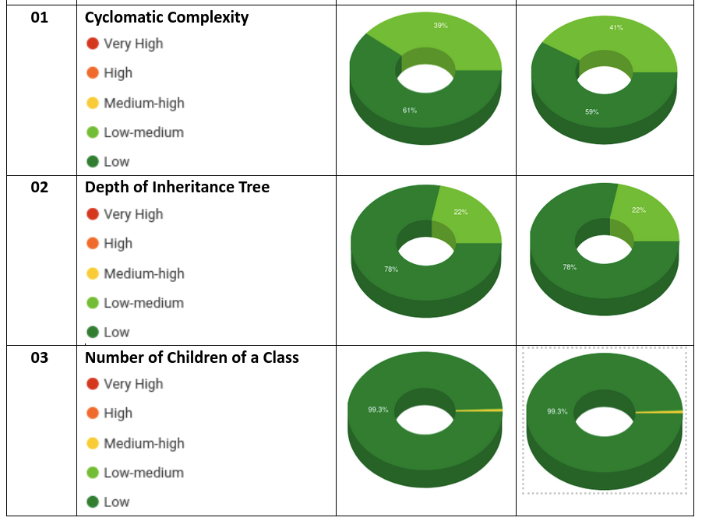
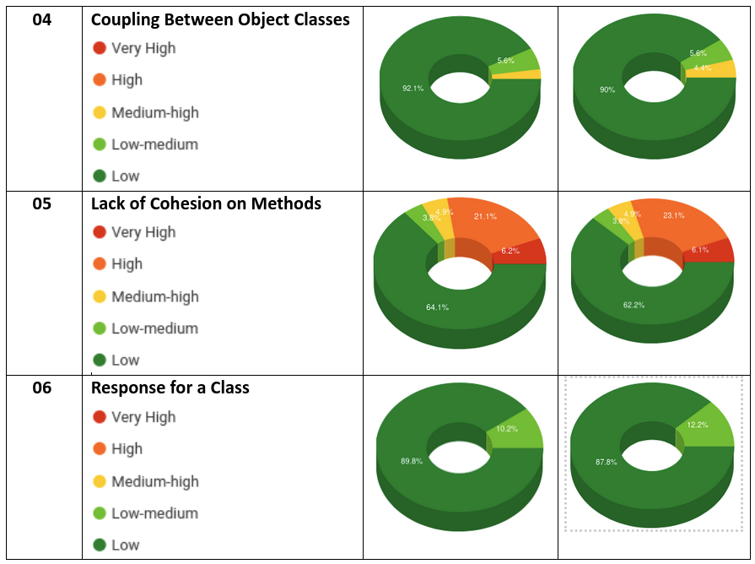
Conduct Code Metrics Analysis using CodeMR Reevaluate the Code Post-Refactoring using CodeMR
S. N. | Metrics | Before Refactoring: Code Metrics | After Refactoring: Code Metrics
S. N. | Metrics | Before Refactoring: Code Metrics | After Refactoring: Code Metrics
Conduct Code Metrics Analysis using CodeMR, For further details, by clicking here.
Reevaluate the Code Post-Refactoring using CodeMR, For further details, by clicking here.
TEAM_11

Slide 13
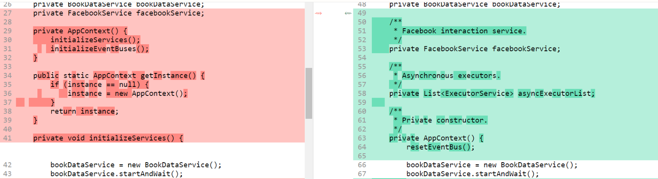
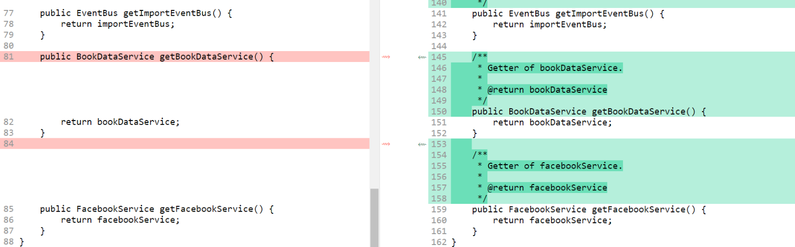
Compare Manual and LLM Refactoring
Where is the design smell?
books-core/src/main/java/com/sismics/books/core/model/context/AppContext.java
Link to the ChatGPT chat
Original Smells detected by us: Singleton Pattern Misuse, God Object, Static Method, Hardcoded Values, Mutable Static State. Please refer to section 2.a for more details.
Smells detected by ChatGPT:
Singleton Pattern: While the singleton pattern ensures there's only one instance of AppContext, it also introduces tight coupling and makes it hard to test.
Resource Management: The code directly creates and starts services (BookDataService, FacebookService) within the constructor, which tightly couples the initialization of services with the AppContext.
Complex Initialization Logic: The resetEventBus() method has complex logic for initializing event buses and executors, making it hard to understand and maintain.
Changes in the code. Red refers to the code generated by ChatGPT, Green is the refactored code by us. Please see the changes below
Removed Singleton Instance
Separated Service Initialization
For further details, by clicking here.
TEAM_11

Slide 14
Bonus Tasks
Findings
Performance with Code Context Length
Longer code contexts resulted in inconsistency and reduced effectiveness in identifying and refactoring code smells.
In scenarios with smaller code contexts, ChatGPT exhibited better performance.
Continuous prompting after each interaction proved to be a viable workaround for maintaining context.
Prompt Dependency
The prompt's nature significantly impacted the output generated by ChatGPT.
Prompt-driven interactions were crucial for steering ChatGPT towards the desired outcomes.
Manual Intervention Requirement
While ChatGPT showed promise, manual intervention was often necessary to ensure the quality of refactored code.
Smaller codebases required less manual intervention and yielded excellent results.
Performance Enhancement through Fine-Tuning
Focusing on training ChatGPT-like models specifically tailored for code smell detection and refactoring could enhance performance and reduce dependency on manual intervention.
TEAM_11

Slide 15
Bonus Tasks...
Introduction: This report documents the design and implementation of an automated pipeline for detecting design smells in a GitHub repository, refactoring the identified issues, and generating pull requests for the changes.
Pipeline Overview:
The pipeline consists of three main components:
Automated Design Smell Detection
Automated Refactoring
Pull Request Generation
Code Snippets Explanation:
Refactoring Code with ChatGPT
This function (refactor code with chatgpt) takes the path to a Java file in a GitHub repository and refactors the code using the OpenAI ChatGPT model. The refactored code is then written to a new file in the repository.
Creating Branch
Function (create branch) creates a new branch in the local repository to push the refactored code changes.
Main Function
The main function (main) orchestrates the entire pipeline by cloning the repository, refactoring the code, committing and pushing the changes to a new branch, and creating a pull request.
For further details, by clicking here.
TEAM_11

Slide 16
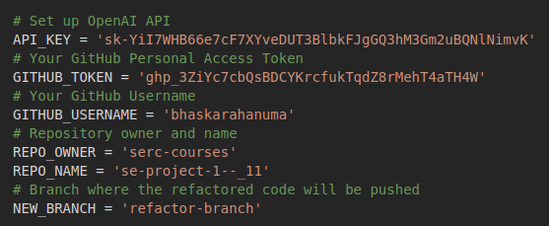
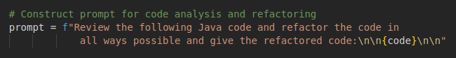
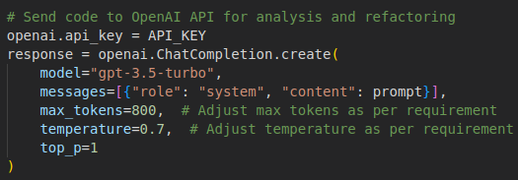
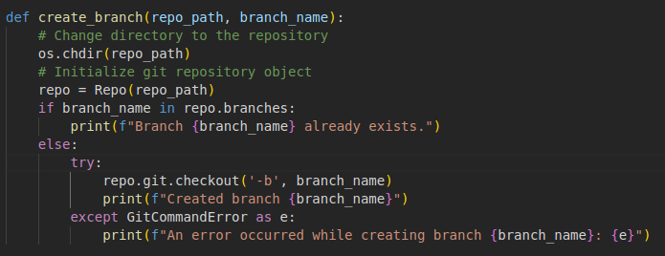
How it Works !!
Set-up: API
2. Code Refactoring with OpenAI's ChatGPT
The refactor_code_with_chatgpt function is defined to refactor Java code using OpenAI's ChatGPT.
It reads the code from a specified file, constructs a prompt for analysis and refactoring, sends the code to OpenAI's API, and retrieves the refactored code from the response.
Prompt:
Model:
3. The refactored code is then written to a new file with a name prefixed by "refactored_".
Pushing the code:
TEAM_11

Slide 17

TEAM_11

